Slide 1
Skin Rash Image Generator Using Fine Tuned Latent Diffusion Models

Slide 2
Problem Statement
Description:
In dermatology, accurate visual representations of skin conditions are crucial for diagnosis, treatment planning, and medical education.
However, the availability of diverse and realistic images representing various skin rashes across different skin tones and body areas is often limited. Traditional datasets may not adequately capture the full range of skin conditions or may lack diversity in skin types, leading to potential biases in medical training and automated diagnosis systems.
Objective:
The goal of this project is to develop a skin rash image generator using a latent diffusion model. The model will be fine-tuned to generate realistic images of various skin rashes, incorporating variations in skin tone, affected body areas, and rash types. These generated images can be used to augment existing dermatological datasets, aiding in the development of more robust and inclusive diagnostic tools.

Slide 3
implementation and libraries used
Library
Diffusers
Transformers
PyTorch
Diffusion Model
Stable Diffusion: CompVis/stable-diffusion-v1-4
CLIP Model: openai/clip-vit-large-patch14
Hosting
StreamLit (Frontend)
Local Tunnel (To run on Colab)

Slide 4
Technical Architecture
CUSTOM IMAGES
IMAGE DESCRIPTIONS
Fine Tune CLIP Model
Data Loader with BERT generated Text Embeddings corresponding Images
Latent Diffusion Model with fine tuned CLIP,UNET,VAE
BERT
Diffusion Model (Combined UNET and VAE)

Slide 5
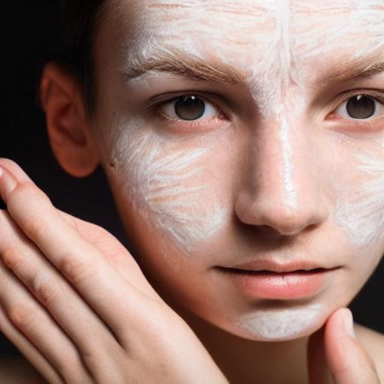
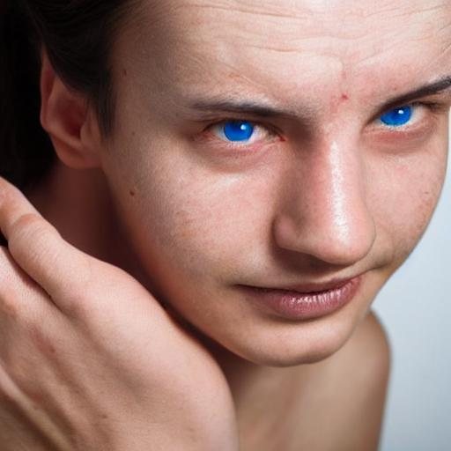
Fine Tuned Model
fair skin person with dermatitis in porous skin
Original Model

Slide 6
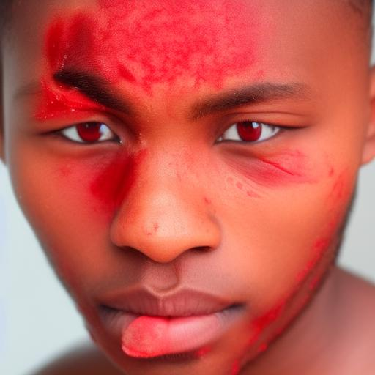
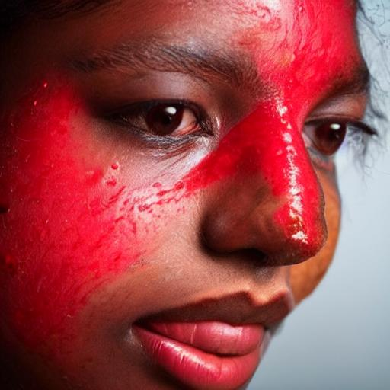
Fine Tuned Model
brown skin person with ringworm infection in red colour on cheek
Original Model

Slide 7
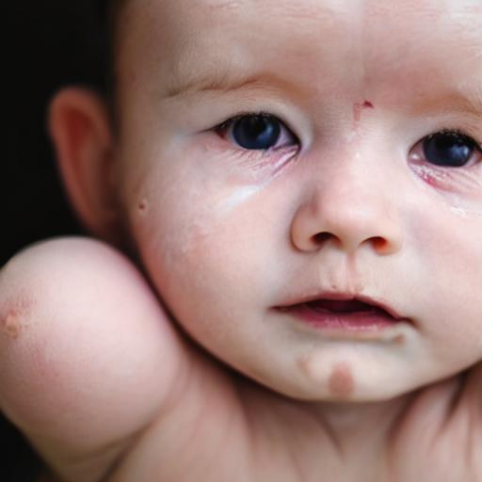
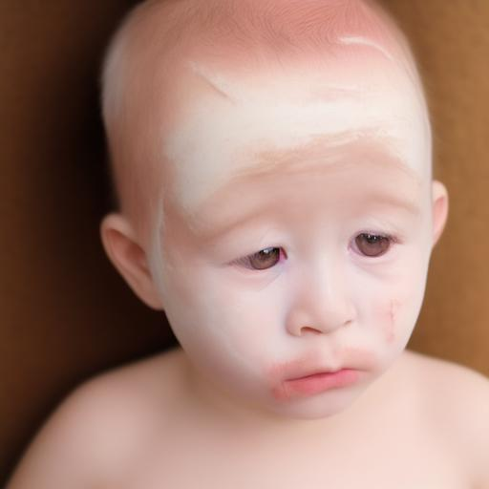
Fine Tuned Model
image of a small baby in fair skin having eczema disease on cheek and forehead
Original Model

Slide 8
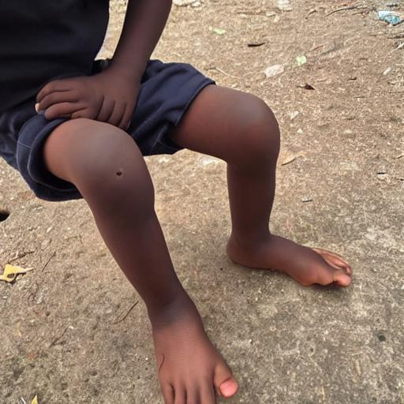
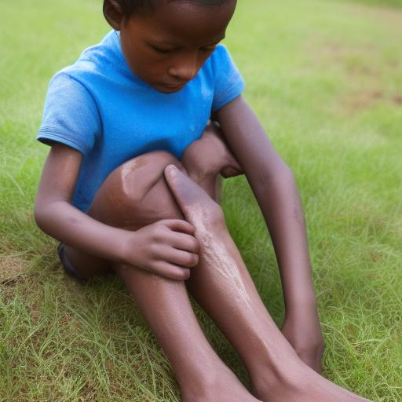
Fine Tuned Model
image of a small boy in brown skin having ringworm disease on leg below knee
Original Model

Slide 9
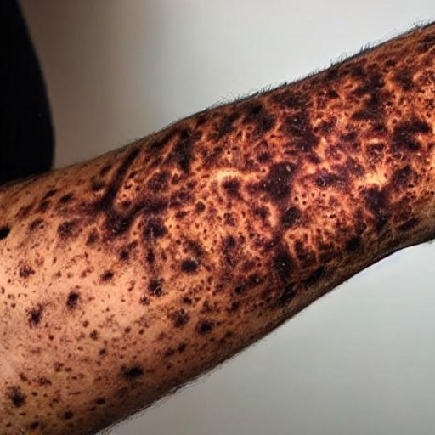
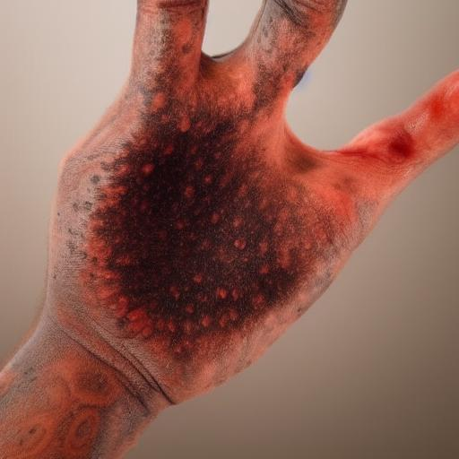
Fine Tuned Model
arm of brown skin person with dermatitis disease with dark brown coloured rash throughout the hand
Original Model

Slide 10
Analysis and Conclusions
Diversity in Output: The fine-tuned latent diffusion model successfully generated images of skin rashes that covered a wide range of skin tones, affected body areas, and rash types.
Realism of Generated Images: The generated images were found to be highly realistic, closely resembling actual clinical images. The fidelity of the images to the provided textual descriptions was also strong, with details such as rash type and location accurately reflected in the output.
Model Fine-Tuning: Fine-tuning the latent diffusion model with a carefully curated dataset resulted in significant improvements in the quality and specificity of the generated images.
Generalization: While the model performed well on the dataset used for fine-tuning, its ability to generalize to completely unseen skin conditions or rare rashes may still be limited. The quality of the generated images is highly dependent on the diversity and representativeness of the training data.

Slide 11
Conclusion
With the help of a latent diffusion model, a skin rash image generator is a tool that allows for dermatologists to better assist their patients.
Generators such as these create realistic images that match with a variety of factors, such as skin color and type of disease.
The project can help remove biases and lead to a wider number of patients being helped.

Slide 12
Future Work
Reinforcement Learning from Human Feedback (RLHF)
Fine-Tuning: Fine-tune the model with reinforcement learning, where human feedback is used to reinforce appropriate outputs and penalize inappropriate ones.
Reward Modeling: Implement a reward model that penalizes the generation of inappropriate content during training.
Prompt Filtering
Keyword Filtering: Implement a system that filters out prompts containing inappropriate keywords or phrases. This can be done by matching the input against a list of banned words.
Natural Language Processing (NLP) Filters: Use NLP techniques to understand the context of the prompt and block or modify requests that might lead to inappropriate content.

